Slide 1




DS105 PROJECT
FILBERT KOH

Slide 2
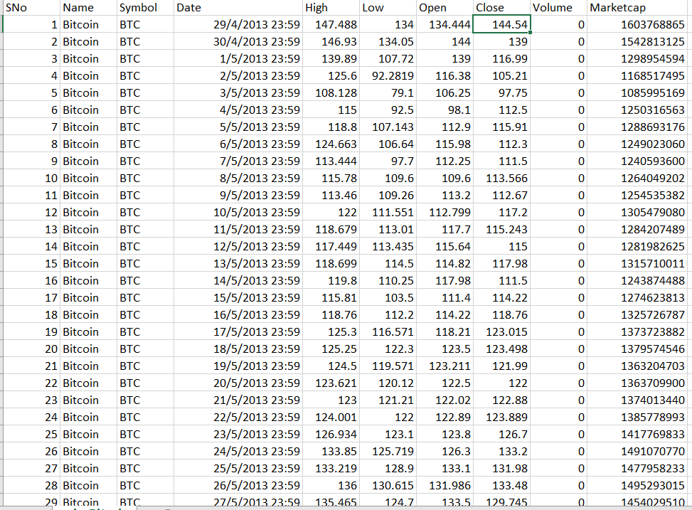
INTRODUCTION TO DATASET
COLLECTION OF DATASETS ON HISTORICAL PRICES FOR DIFFERENT CRYPTOCURRENCIES
HTTPS://WWW.KAGGLE.COM/DATASETS/SUDALAIRAJKUMAR/CRYPTOCURRENCYPRICEHISTORY

Slide 3
DATASET
1
COLLECTION OF DIFFERENT CRYPTOCURRENCIES
Total of 23 cryptocurrencies, including Bitcoin (BTC), Ethereum (ETH), Ripple (XRP) and Binance Coin (BNB)
2
SIZE RANGING FROM ~300-3000 ROWS
Depending on the age of the cryptocurrency
3
8 COLUMNS/ATTRIBUTES FOR EACH CRYPTOCURRENCY

Slide 4
ATTRIBUTE DESCRIPTION
SNo: Serial Number
Name: Name of Cryptocurrency
Symbol: Ticker Symbol of Currency/Coin (e.g. BTC/ETH)
Date: Date of Recording
High: Highest Price on the given day
Low: Lowest Price on the given day
Open: Opening Price on the given day
Close: Closing Price for the given day
Volume: Number of coins/units of cryptocurrency traded on the given day
Marketcap: Total Value of the given Cryptocurrency

Slide 5
PROBLEM STATEMENT
A FRIEND, JACOB, IS LOOKING TO INVEST IN CRYPTOCURRENCY. HE IS LOOKING AT STABLE COINS, BITCOIN & ETHEREUM FOR A SAFE START TO HIS INVESTMENT JOURNEY
DO 6 MONTH PRICE PREDICTIONS FOR BOTH BITCOIN & ETHEREUM FROM THE CURRENT DAY (24 NOV) TO GAIN SOME INSIGHT INTO WHICH CRYPTOCURRENCY JACOB SHOULD INVEST, IF AT ALL.

Slide 6
DISCLAIMER
NONE OF THE DATA IN THIS PRESENTATION IS MEANT TO BE ACTUAL INVESTMENT ADVICE.

Slide 7

1
DATA
PRE-PROCESSING

Slide 8
DATA PRE-PROCESSING
1
INCOMPLETE DATA
Original dataset only contains data up till 6 June 2021
Separate data from Yahoo Finance imported to update the data to the present day (24 Nov 2022)
2
NULL VALES & DUPLICATED DATA CHECK
We are using only the 'Date' and 'Close' columns.
Null values are present but not located in either column, so we will ignore the null values.
There are no duplicated rows.
3
DATA TYPE CONVERSION
''Date' column data type converted from str to datetime object

Slide 9
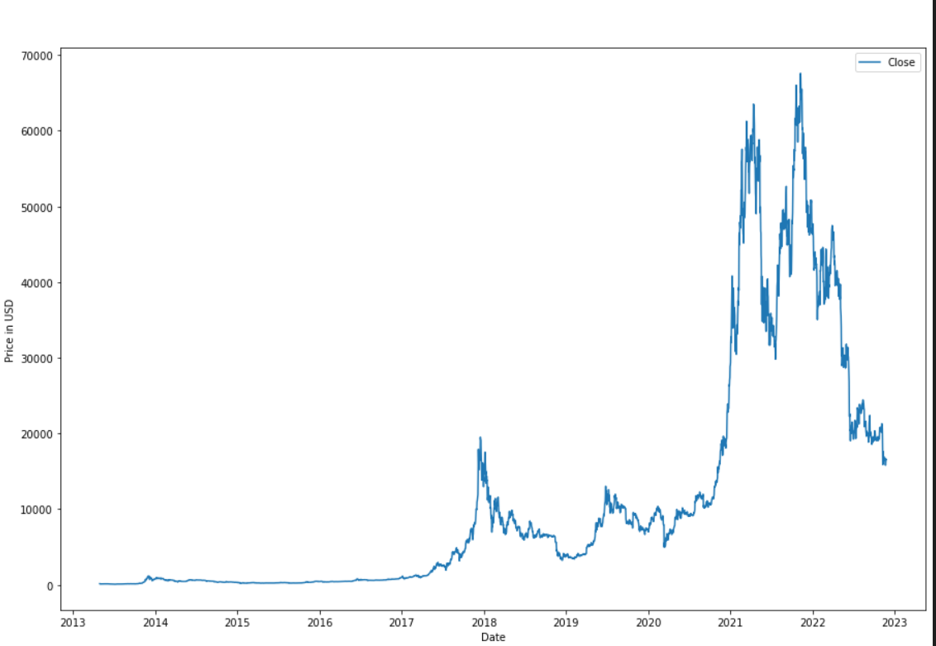
BITCOIN
HISTORICAL
PRICES

Slide 10
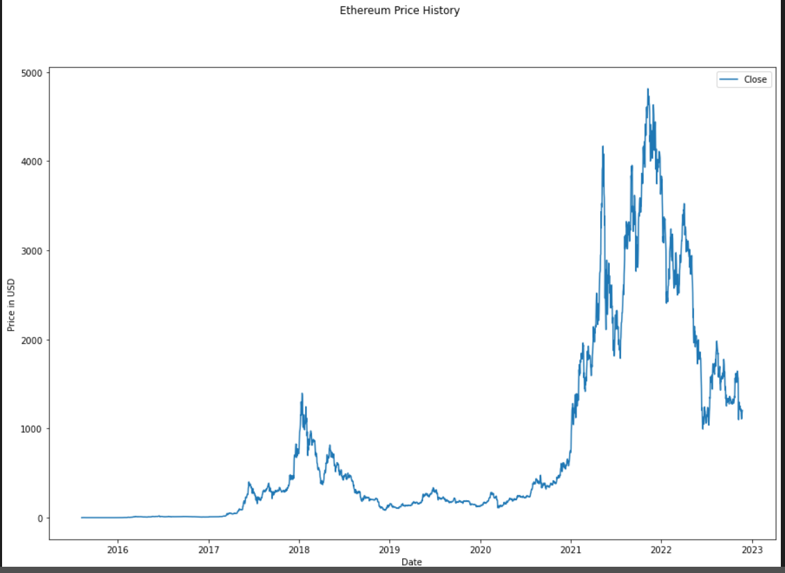
ETHEREUM
HISTORICAL
PRICES

Slide 11
2
TRAIN/TEST SPLIT + FEATURE SCALING

Slide 12
TRAIN/TEST SPLIT + FEATURE SCALING
80/20 TRAIN TEST/SPLIT
TRAINING SET NORMALIZED, TEST SET UNSCALED
THE PREVIOUS 60 DAYS DATA WILL BE USED TO PREDICT THE NEXT DAY PRICE.
X_TRAIN CONTAINS A 60 DAYS WINDOW OF DATA, Y_TRAIN CONTAINS THE FOLLOWING 60 DAYS WINDOW OF DATA
SIMILAR FOR X_TEST. Y_TEST WILL CONTAIN THE FINAL 20% OF PRICE DATA, UNSCALED

Slide 13
3
SETTING UP LSTM NETWORK

Slide 14
LSTM NETWORK
1
SEQUENTIAL MODEL USED
A keras.Sequential model was used as this model is generally used to work with time series data prediction.
2
LSTM LAYERS
These learn the dependencies between time steps. Number of layers to be added can be specified when setting up the model
3
DENSE LAYERS
Dense layers are intricately connected to the preceding layers and use the output from them to do predictions. Number of dense layers can also be specified.

Slide 15
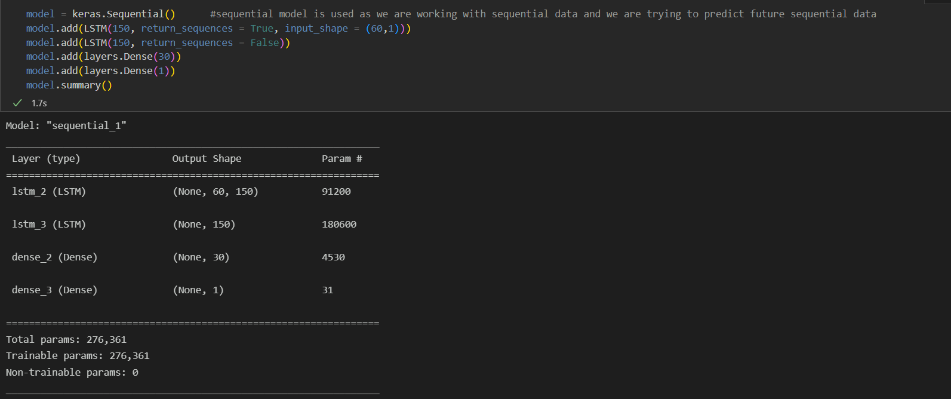
LSTM NETWORK

Slide 16
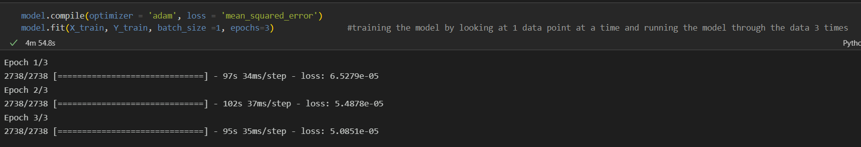
TRAINING THE MODEL
OPTIMIZER TO COMPILE ALL THE DIFFERENT LAYERS INTO A WORKING MODEL, LOSS FUNCTION IS AN EVALUATION METRIC
FITTING THE MODEL BY LOOKING AT EACH INDIVIDUAL DATA POINT AT A TIME (BATCH_SIZE)
RUN THE MODEL THROUGH THE DATA 3 TIMES (EPOCH)

Slide 17
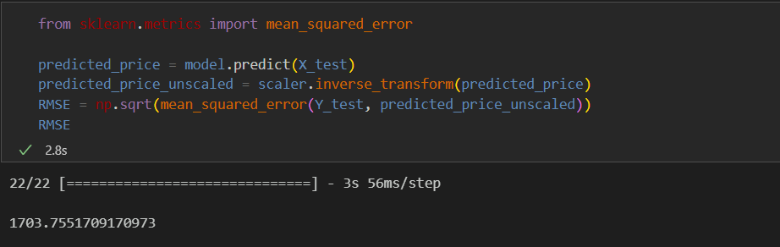
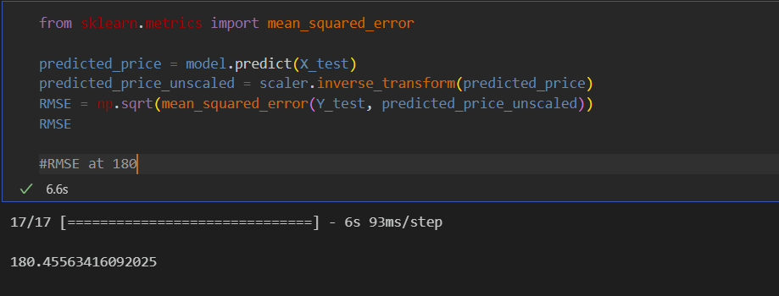
MODEL EVALUATION (RMSE)
RMSE = 1703
MEAN = $11,020
~15 % Error
RMSE = 180
MEAN = $800
~22% Error

Slide 18
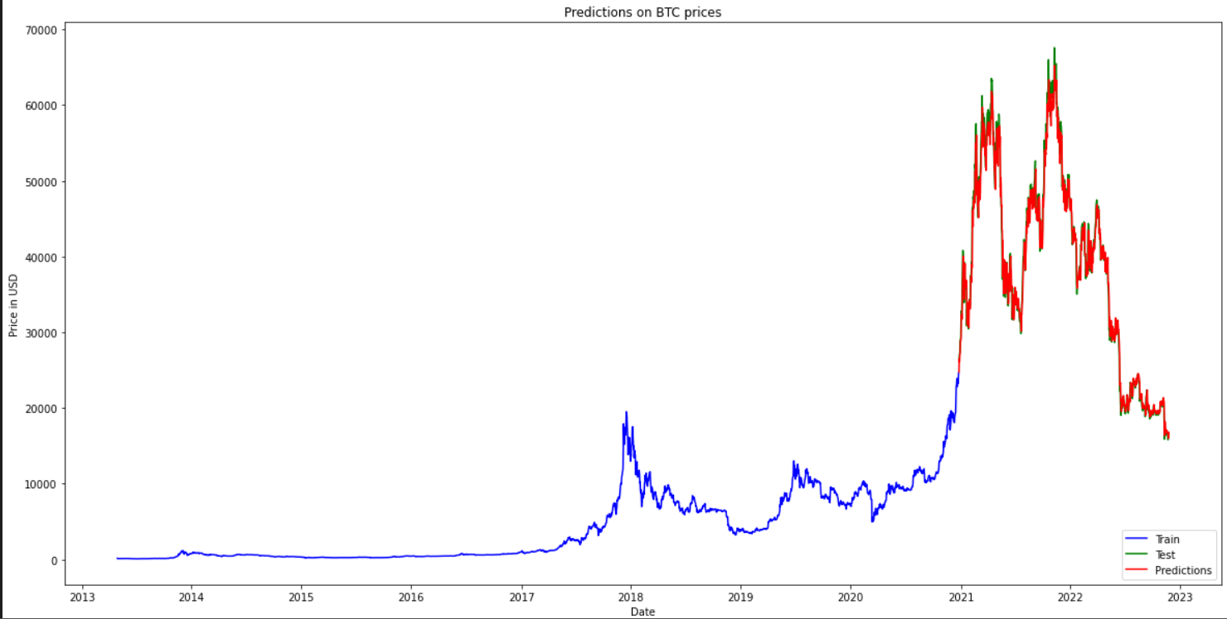
TEST DATA VS PREDICTIONS

Slide 19

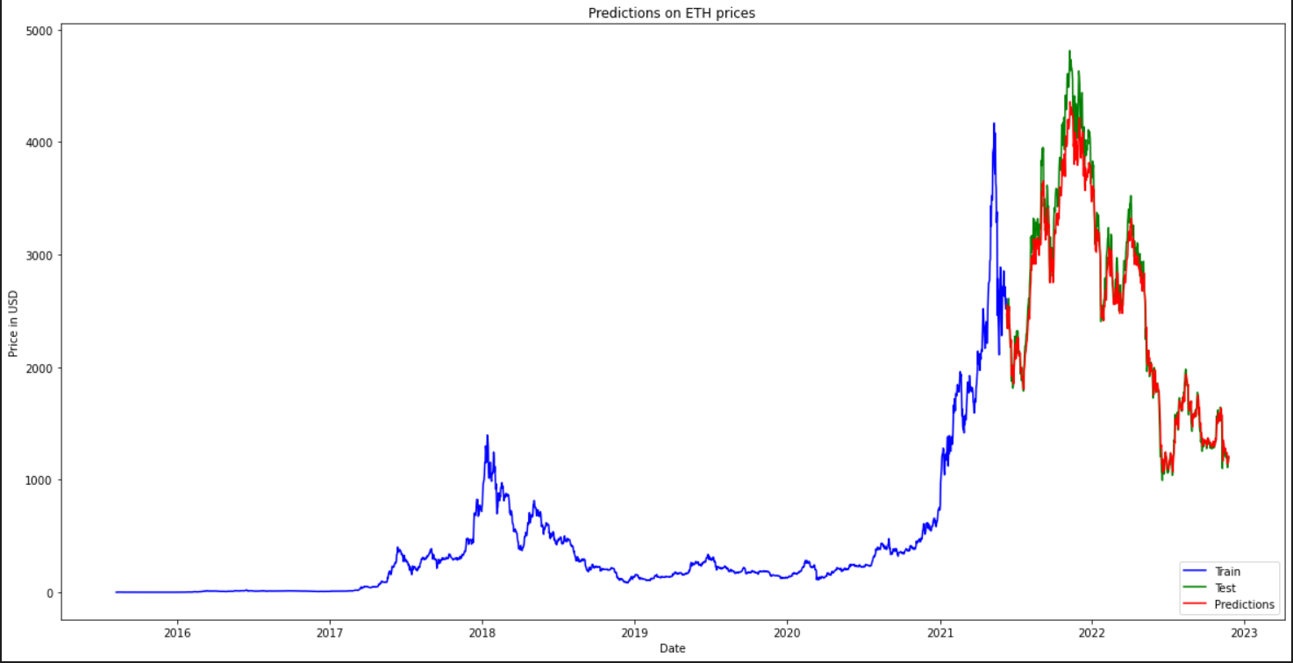
TEST DATA VS PREDICTIONS

Slide 20
4
PREDICTING PRICES PAST PRESENT DAY

Slide 21
PREDICTING PRICES PAST PRESENT DAY
MODEL USES THE PAST 60 DAYS DATA TO PREDICT 1 DAY FORWARD
E.G. FOR PREDICTION ON 25 NOV 2022, PAST 60 DAYS DATA STARTING FROM 24 NOV 2022 WILL BE USED
FOR PREDICTION ON 26 NOV 2022, PAST 60 DAYS DATA STARTING FROM 25 NOV 2022 WILL BE USED
PREDICTED PRICE ON 25 NOV 2022 WILL BE THE Y_TEST DATA FOR 26 NOV 2022 PRICE PREDICTION

Slide 22
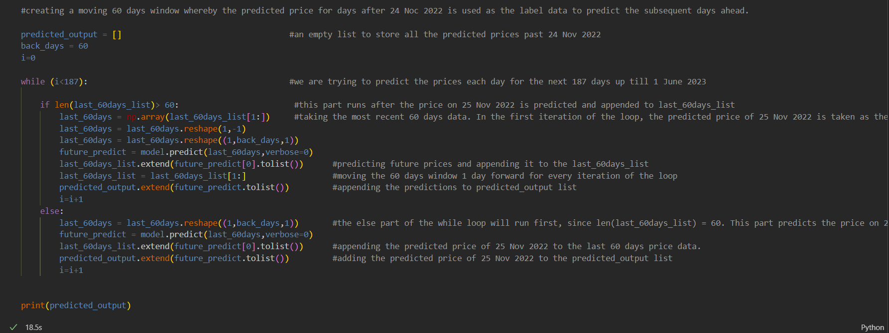
PREDICTING PRICES PAST PRESENT DAY
MOVING 60 DAYS WINDOW NEED TO BE PROGRAMMED TO PREDICT PRICES EVERYDAY FOR THE NEXT 6 MONTHS
CREDITS TO: HTTPS://WWW.YOUTUBE.COM/WATCH?V=5GM3BWNBOWQ

Slide 23
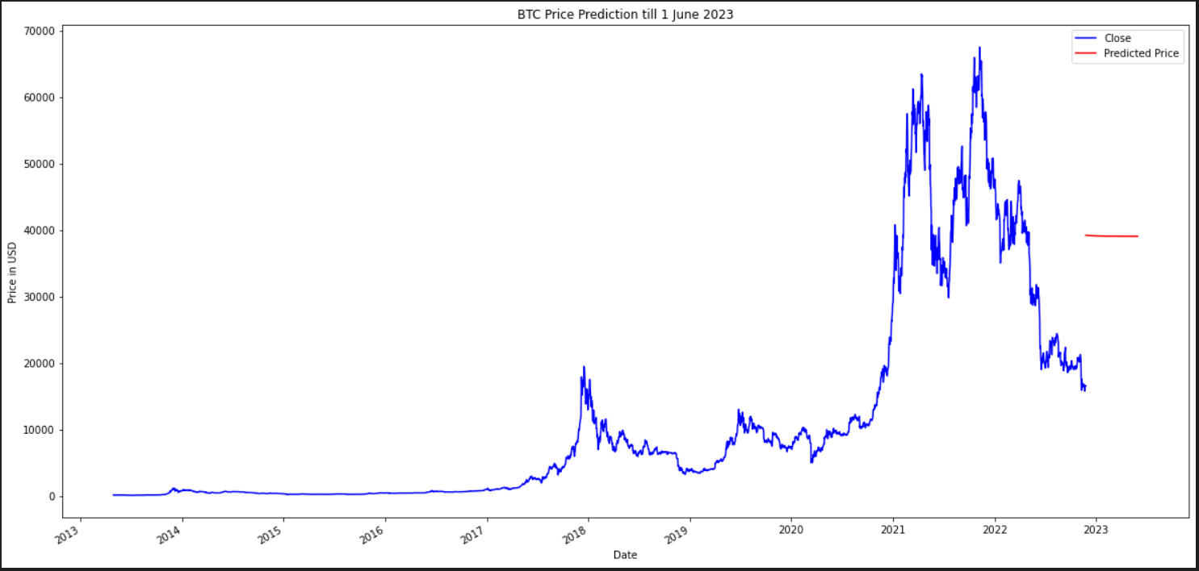
PREDICTING PRICES PAST PRESENT DAY

Slide 24
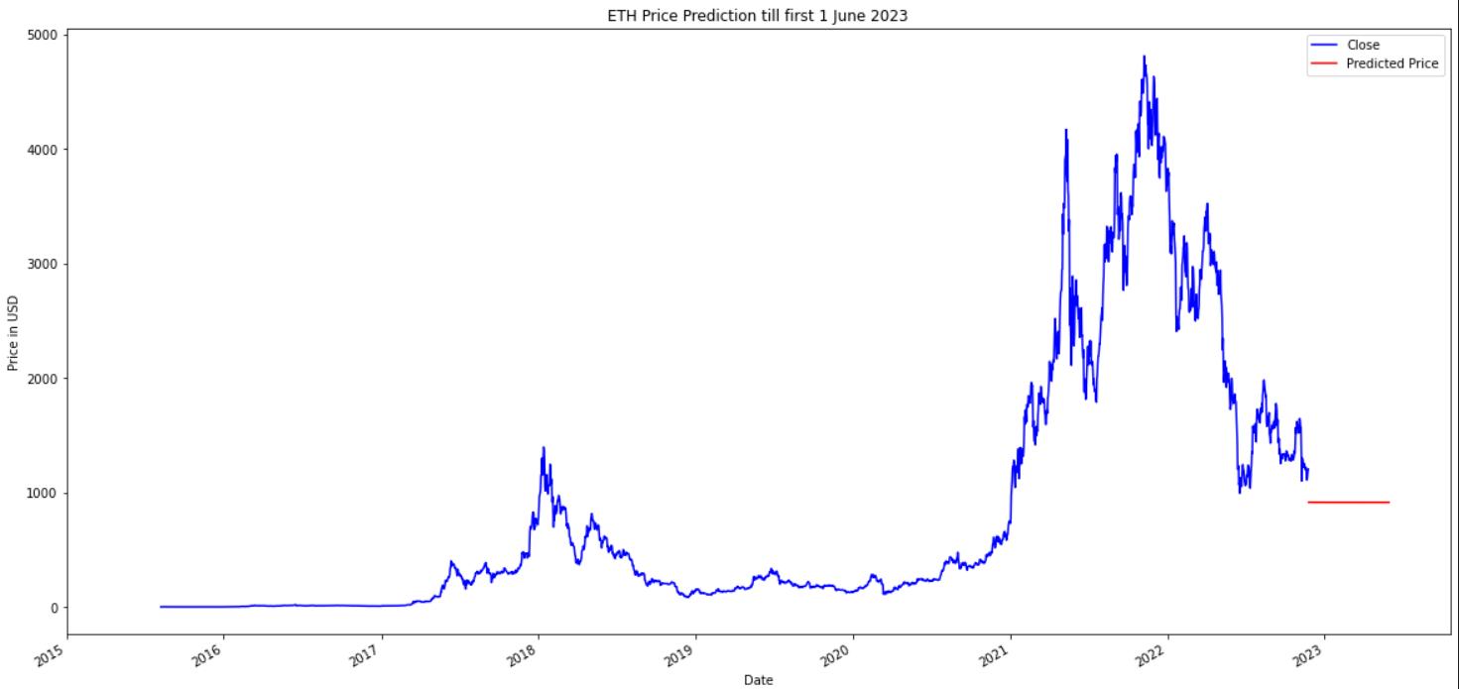
PREDICTING PRICES PAST PRESENT DAY

Slide 25
WHICH TO INVEST?
BITCOIN
ETHEREUM
BASED SOLELY ON LSTM PREDICTIONS, BITCOIN SEEMS TO BE THE MORE FAVOURABLE OPTION AS IT IS MORE LIKELY TO YIELD A POSITIVE INVESTMENT YIELD IN THE SHORT TERM. IT IS ALSO MORE LARGE SCALE AND STABLE THAN ETHEREUM
BASED SOLELY ON LSTM PREDICTIONS, THIS IS NOT A FAVOURABLE INVESTMENT OPTION AS IT IS PREDICTED TO RETURN A LOSS IN THE SHORT TERM. HOWEVER, ENTRY PRICE IS LOWER AND IT IS MORE LIKELY TO EXPERIENCE HIGHER GROWTH THAN BITCOIN IN THE LONG TERM.

Slide 26
LIMITATIONS
1
OTHER FACTORS NOT TAKEN INTO ACCOUNT
In reality, crypto prices are affected by many other factors, not just time.
2
PRICE TRENDS NOT CAPTURED
the machine learning model did not capture any future price trends.
3
LOW ACCURACY OF "ANALYST'S PREDICTIONS"
"Analyst's predictions/forecasts" are not always accurate, hence these predicted prices may not happen in future.

Slide 27
THANK YOU!
GITHUB LINK: https://github.com/adonis941

